Slide 1
Chapter Six
Architecture and Business
By: Abenezer Fantu

Slide 2
Economic Analysis of Architectures
Outline
Decision-Making Context
The Basis for the Economic Analyses
Putting Theory into Practice: The CBAM
Case Study: The NASA ECS Project
Summary

Slide 3
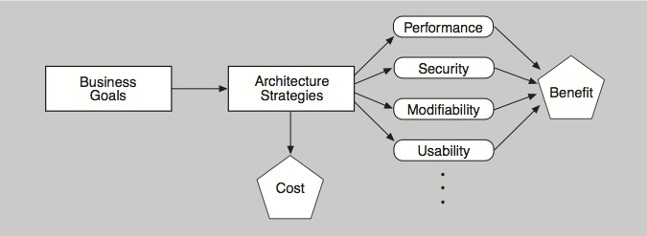
Decision-making Context
The quality attributes achieved by architecture decisions have economic implications in terms of the benefits (utility) that can be derived from those decisions.
This interplay between the costs and the benefits of architectural decisions guides (and torments) the architect.

Slide 4
Decision-making Context
Example:
Using redundant hardware to achieve a desired level of availability has a cost
But this architectural decision will result in measurable levels of availability that will have some value to the organization developing the system.
Knowing the costs and benefits associated with particular decisions enables reasoned selection from among competing alternatives.
Economic analysis does not make decisions for the stakeholders. It simply aids in the elicitation and documentation of value for cost (VFC).
VFC: a function of the costs, benefits, and uncertainty of a “portfolio”(range) of architectural investments.
It gives the stakeholders a framework within which they can apply a rational decision-making process that suits their needs and their risk aversion.
Economic analysis isn’t something to apply to every architectural decision, but rather to the most basic ones that put an overarching architectural strategy in place.

Slide 5
Utility-Response Curves
Our economic analysis uses quality attribute scenarios as the way to concretely express and represent specific quality attributes.
When we vary the values of the responses, and ask what the utility is of each response we get a set of points that we can plot: a utility-response curve.
Each scenario’s stimulus-response pair provides some utility (value) to the stakeholders, and the utility of different possible values for the response can be compared.
With prodding, stakeholders can express their needs using concrete response measures, such as “99.999 percent available.” But how much would they value slightly less demanding quality attributes, such as “99.99 percent available”? Would that be almost as good?
If so, then the lower cost of achieving that lower value might make that the preferred option,
Capturing the utility of alternative responses of a scenario better enables the architect to make tradeoffs involving that quality attribute.
We can portray each relationship between a set of utility measures and a corresponding set of response measures as a graph—a utility-response curve.

Slide 6
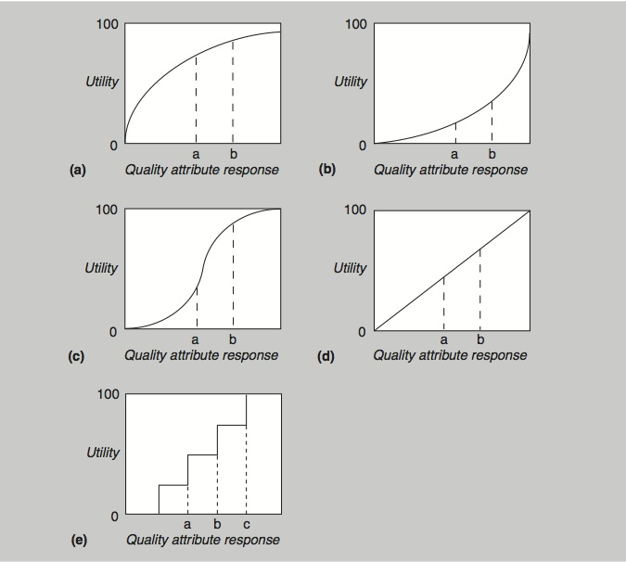
Example Utility-Response Curves

Slide 7
Weighting the Scenarios
Different scenarios will have different importance to the stakeholders.
To make a choice of architectural strategies that is best suited to the stakeholders’ desires, we must weight the scenarios.
It does no good to spend a great deal of effort optimizing a scenario in which the stakeholders actually have very little interest.

Slide 8
Determining Benefit and Normalization
The overall benefit of an architectural strategy across various quality attribute scenarios is the sum of the utility associated with each scenario, weighted by the importance of the scenario.
For each architectural strategy i, its benefit B_{i} over j scenarios (each with weight W_{j}) is
B_{i} = ∑_{j} (b_{i,j} × W_{j})
Each b_{i,j} is calculated as the change in utility (over whatever architectural strategy is currently in place, or is in competition with the one being considered) brought about by the architectural strategy with respect to this scenario:
b_{i,j} = U_{expected} – U_{current}
This is the utility of the expected value of the architectural strategy minus the utility of the current system relative to this scenario.

Slide 9
Calculating Value for Cost
The VFC for each architectural strategy is the ratio of the total benefit, B_{i}, to the cost, C_{i}, of implementing it:
VFC = B_{i} / C_{i}
The cost C_{i} is estimated using a model appropriate for the system and the environment being developed, such as a cost model that estimates implementation cost by measuring an architecture’s interaction complexity.
You can use this VFC score to rank-order the architectural strategies under consideration.

Slide 10
Practicalities of Utility Curve Determination
To build the utility-response curve, we first determine the quality attribute levels for the best-case and worst-case situations.
The best-case quality attribute level is that above which the stakeholders foresee no further utility.
For example, a system response to the user of 0.1 second is perceived as instantaneous, so improving it further so that it responds in 0.03 second has no additional utility.
The worst-case quality attribute level is a minimum threshold above which a system must perform; otherwise it is of no use to the stakeholders.
These levels—best-case and worst-case—are assigned utility values of 100 and 0, respectively.

Slide 11
Practicalities of Weighting Determination
One method of weighting the scenarios is to prioritize them and use their priority ranking as the weight.
For N scenarios, the highest priority one is given a weight of 1, the next highest is given a weight of (N–1)/N, and so on.
This turns the problem of weighting the scenarios into one of assigning priorities.
The stakeholders can determine the priorities through a variety of voting schemes.
One simple method is to have each stakeholder prioritize the scenarios (from 1 to N) and the total priority of the scenario is the sum of the priorities it receives from all of the stakeholders.
Voting can be public or secret.
Other schemes are possible. Regardless of the scheme used, it must make sense to the stakeholders and it must suit their culture.

Slide 12
Practicalities of Cost Determination
There are very few cost models for various architectural strategies.
There are many software cost models, but they are based on overall system characteristics such as size or function points.
These are inadequate to answer the question of how much does it cost to, for example, use a publish-subscribe pattern in a particular portion of the architecture.
There are cost models that are based on complexity of modules (by function point analysis according to the requirements assigned to each module) and the complexity of module interaction, but these are not widely used in practice.
More widely used in practice are corporate cost models based on previous experience with the same or similar architectures, or the experience and intuition of senior architects.

Slide 13
Practicalities of Cost Determination
Architects often turn to cost estimation techniques.
An absolute number for cost isn’t necessary to rank candidate architecture strategies.
You can often say something like “Suppose strategy A costs $x. It looks like strategy B will cost $2x, and strategy C will cost $0.5x.” That’s enormously helpful.
A second approach is to use very coarse estimates. Or if you lack confidence for that degree of certainty, you can say something like “Strategy A will cost a lot, strategy B shouldn’t cost very much, and strategy C is probably somewhere in the middle.”

Slide 14
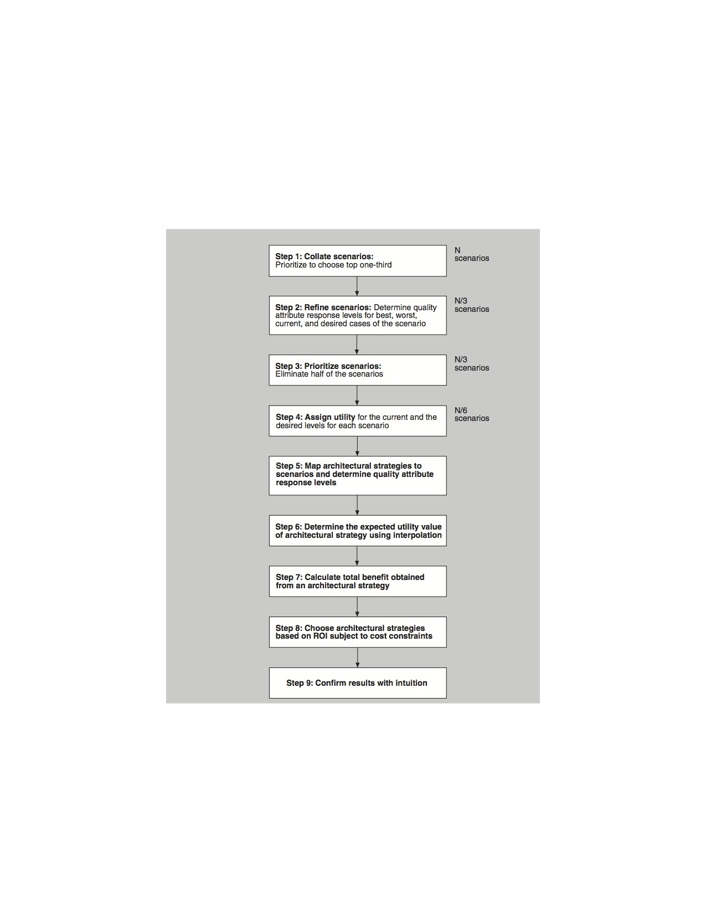
Cost Benefit Analysis Method (CBAM)
The CBAM places the
principles just discussed into
a set of steps: a method.

Slide 15
CBAM / Cost Benefit Analysis Model Stakeholders
The stakeholders in a CBAM exercise include people who can authoritatively speak to the utility of various quality attribute responses.
They probably include the same people who were the source of the quality attribute scenarios being used as input.

Slide 16
Step 1
Collate scenarios.
Give the stakeholders the chance to contribute new scenarios.
Ask the stakeholders to prioritize the scenarios based on satisfying the business goals of the system.
This can be an informal prioritization using a simple scheme such as “high, medium, low” to rank the scenarios.
Choose the top one-third for further study.

Slide 17
Step 2
Refine scenarios.
Refine the scenarios chosen in step 1, focusing on their stimulus-response measures.
Elicit the worst-case, current, desired, and best-case quality attribute response level for each scenario.
For example, a refined performance scenario might tell us that worst-case performance for our system’s response to user input is 12 seconds, the best case is 0.1 seconds, and our desired response is 0.5 seconds. Our current architecture provides a response of 1.5 seconds.

Slide 18
Step 3
Prioritize scenarios.
Prioritize the refined scenarios, based on stakeholder votes.
Give 100 votes to each stakeholder and have them distribute the votes among the scenarios, where their voting is based on the desired response value for each scenario.
Total the votes and choose the top 50 percent of the scenarios for further analysis.
Assign a weight of 1.0 to the highest-rated scenario; assign the other scenarios a weight relative to the highest rated.
This becomes the weighting used in the calculation of a strategy’s overall benefit.
Make a list of the quality attributes that concern the stakeholders.

Slide 19
Step 4
Assign utility.
Determine the utility for each quality attribute response level (worst-case, current, desired, best-case) for the scenarios from step 3.
You can conveniently capture these utility curves in a table (one row for each scenario, one column for each of the four quality attribute response levels).

Slide 20
Step 5
Map architectural strategies to scenarios and determine their expected quality attribute response levels.
For each architectural strategy under consideration, determine the expected quality attribute response levels that will result for each scenario.

Slide 21

Step 6
Determine the utility of the expected quality attribute response levels by interpolation.
Using the elicited utility values (that form a utility curve), determine the utility of the expected quality attribute response level for the architectural strategy.
Do this for each relevant quality attribute enumerated in step 3.
For example, if we are considering a new architectural strategy that would result in a response time of 0.7 seconds, we would assign a utility proportionately between 50 (which it exceeds) and 80 (which it doesn’t exceed).
The formula for interpolation between two data points (x_{a}, y_{a}) and (x_{b}, y_{b}) is:
For us, the x values are the quality attribute response levels and the y values are the utility values. So, employing this formula, the utility value of a 0.7-second response time is 74 .

Slide 22
Step 7
Calculate the total benefit obtained from an architectural strategy.
Subtract the utility value of the “current” level from the expected level and normalize it using the votes elicited in step 3.
Sum the benefit due to a particular architectural strategy across all scenarios and across all relevant quality attributes.

Slide 23
Step 8
Choose architectural strategies based on VFC subject to cost and schedule constraints.
Determine the cost and schedule implications of each architectural strategy.
Calculate the VFC value for each as a ratio of benefit to cost. Rank-order the architectural strategies according to the VFC value and choose the top ones until the budget or schedule is exhausted.

Slide 24
Step 9
Confirm results with intuition.
For the chosen architectural strategies, consider whether these seem to align with the organization’s business goals.
If not, consider issues that may have been overlooked while doing this analysis.
If there are significant issues, perform another iteration of these steps.

Slide 25
Case Study: The NASA ECS Project
The Earth Observing System is a constellation of NASA satellites that gathers data for the U.S. Global Change Research Program and other scientific communities worldwide.
The Earth Observing System Data Information System (EOSDIS) Core System (ECS) collects data from various satellite downlink stations for further processing.
ECS’s mission is to process the data into higher-form information and make it available to scientists in searchable form. The goal is to provide both a common way to store (and hence process) data and a public mechanism to introduce new data formats and processing algorithms, thus making the information widely available.

Slide 26
Step 1: Collate Scenarios
Collected Scenarios in Priority Order
Reduce data distribution failures that result in hung distribution requests requiring manual intervention.
Reduce data distribution failures that result in lost distribution requests.
Reduce the number of orders that fail on the order submission process.
Reduce order failures that result in hung orders that require manual intervention.
Reduce order failures that result in lost orders.
There is no good method of tracking ECSGuest failed/canceled orders without much manual intervention (e.g., spreadsheets).
Users need more information on why their orders for data failed.
Because of limitations, there is a need to artificially limit the size and number of orders.
Small orders result in too many notifications to users.
The system should process a 50-GB user request in one day, and a 1-TB user request in one week.
Note that they are not yet well formed and that some of them do not have defined responses. These issues are resolved in step 2, when the number of scenarios is reduced.

Slide 27
Step 2: Refine Scenarios
The scenarios were refined, paying particular attention to precisely specifying their stimulus-response measures.
The worst-case, current-case, desired-case, and best-case response goals for each scenario were elicited and recorded in a table.

Slide 28
Step 2: Refine Scenarios

Slide 29
Step 3: Prioritize Scenarios
In voting on the refined representation of the scenarios, the close-knit team deviated slightly from the method.
Rather than vote individually, they chose to discuss each scenario and arrived at a determination of its weight via consensus.
The votes allocated to the entire set of scenarios were constrained to 100.
Although the stakeholders were not required to make the votes multiples of 5, they felt that this was a reasonable resolution and that more precision was neither needed nor justified.

Slide 30
Step 3: Prioritize Scenarios

Slide 31
Step 4: Assign Utility
In this step the utility for each scenario was determined by the stakeholders, again by consensus.
A utility score of 0 represented no utility; a score of 100 represented the most utility possible.

Slide 32
Step 4: Assign Utility

Slide 33
Step 5: Develop Architectural Strategies and Determine Their Expected Quality Attribute Response Levels
Based on the requirements implied by the preceding scenarios, a set of 10 architectural strategies was developed by the ECS architects.
For each architectural strategy/scenario pair, the response levels expected to be achieved with respect to that scenario are shown (along with the current response, for comparison purposes).

Slide 34
Step 5 Results (Strategies 1-5)

Slide 35
Step 5 Results (Strategies 5-10)

Slide 36
Step 6: Determine the Utility of the “Expected” Quality Attribute Response Levels by Interpolation
Once the expected response level of every architectural strategy has been characterized with respect to a set of scenarios, their utility can be calculated by consulting the utility scores for each scenario’s current and desired responses for all of the affected attributes.
Using these scores, we may calculate, via interpolation, the utility of the expected quality attribute response levels for the architectural strategy/scenario pair.

Slide 37
Step 6 Results

Slide 38
Step 7: Calculate the Total Benefit Obtained from an Architectural Strategy
Total benefit of each architectural strategy can now be calculated:
B_{i} = ∑_{j} (b_{i,j} × W_{j})
This equation calculates total benefit as the sum of the benefit that accrues to each scenario, normalized by the scenario’s relative weight.
Using this formula, the total benefit scores for each architectural strategy are now calculated.

Slide 39
Step 7

Slide 40
Step 8: Choose Architectural Strategies Based on VFC Subject to Cost Constraints
To complete the analysis, the team estimated cost for each architectural strategy.
The estimates were based on experience with the system, and a return on investment for each architectural strategy was calculated.
Using the VFC, we were able to rank each strategy.
The ranks roughly follow the ordering in which the strategies were proposed: strategy 1 has the highest rank; strategy 3 the second highest. Strategy 9 has the lowest rank; strategy 8, the second lowest.
This simply validates stakeholders’ intuition about which architectural strategies were going to be of the greatest benefit. For the ECS these were the ones proposed first.

Slide 41
Step 8

Slide 42
Summary
Architecture-based economic analysis is grounded on understanding the utility-response curve of various scenarios and casting them into a form that makes them comparable.
Once they are in this common form—based on the common coin of utility—the VFC for each architecture improvement, with respect to each relevant scenario, can be calculated and compared.
Applying the theory in practice has a number of practical difficulties, which CBAM solves.
The application of economic techniques is inherently better than the ad hoc decision-making approaches that projects employ today.
Giving people the appropriate tools to frame and structure their discussions and decision making is an enormous benefit to the disciplined development of a complex software system.

Slide 43
Architecture Competence
Outline
Competence of Individuals: Duties, Skills, and Knowledge of Architects
Competence of a Software Architecture
Organization
Summary

Slide 44
Competence of Individuals
Duties
Skills
Knowledge

Slide 45
Technical Duties of an Architect
General Duty | Specific Duties
Architecting | Creating an architecture
 | Evaluating and analyzing an architecture
 | Documenting an architecture
 | Working with and transforming other systems
 | Performing other architecting duties
Other life cycle activities | Managing the requirements
 | Implementing the product
 | Testing the product
 | Evaluation future technologies
 | Selecting tools and technology

Slide 46
Non-Technical Duties of an Architect
General Duty | Specific Duties
Management | Managing the project
 | Managing the people
 | Supporting the management
Organization and business related duties | Supporting the organization
 | Supporting the business
Leadership and team building | Providing technical leadership
 | Building a team

Slide 47
Skills of an Architect
General Skill Area | Specific Skills
Communication skills | Outward
 | Inward
Interpersonal skills | Within team
 | With other people
Work skills | Leadership
 | Workload management
 | Skills to excel in corporate environment
 | Skills for handling information
 | Skills for handling unexpected

Slide 48
Knowledge of an Architect
General Knowledge Area | Specific Knowledge
Computer Science knowledge | Architecture
 | Software Engineering
 | Design knowledge
 | Programming knowledge
Technology and Platforms | Specific knowledge
 | General knowledge
Organization context and management | Domain knowledge
 | Industry knowledge
 | Enterprise knowledge
 | Leadership and management techniques

Slide 49
Organizational Competence
It is not enough for the architect to be competent
The organizational setting is usually outside the control of individual architects.
The architect must operate in an environment that understands how to create/nurture/reward architects.

Slide 50
Some Examples of Activities by a Competent Organization
Establish a career track for architects.
Establish a clear statement of responsibilities and authority for architects.
Establish a mentoring program for architects.
Establish an architecture training/education program.
Include architecture milestones in project plans.
Have architects provide input into product definition.
Have architects advise on development team structure.
Give architects influence throughout the entire project life cycle.
Reward or penalize architects based on project success or failure.

Slide 51
Assessing an Organization
There are three practice areas that can be used to assess an organization's competence.
Software Engineering
Technical Management
Organizational Management

Slide 52
Software Engineering
Organizations should have defined practices for
Quality Attribute Elicitation
Tools and Technology Selection
Modeling and Prototyping
Architecture Design
Architecture Description
Architecture Evaluation
System Implementation
Software Design (design conforms to architecture)
Software Coding (code conforms to design and architecture)
Software Verification
Proving Properties of the Software
Software Testing

Slide 53
Technical Management
Organizations should have defined practices for
Business or Mission Goals
Setting goals
Setting functional requirements
Allocating Resources
Setting architect’s workload and schedule
Funding stakeholder involvement
Project plan structure aligned with architecture structure.
Adequate time planned for architecture evaluation.
Establish organization-wide architecture practices
Process monitoring and improvement
Reuse
Collaboration with manager

Slide 54
Organizational Management
Organizations should have defined practices for
Career track for Architects
Leadership roles for architects
Succession planning
Ongoing training
Creating and sustaining an internal community of architects
Supporting participation in external communities
Organizational Planning
Technology Planning and Forecasting

Slide 55
Questions within Competence Categories
Within each competence category one can have questions to evaluate how well an organization measures against particular criteria. E.g.
How do you ensure that the architecture is aligned with the business goals?
What is the input into the architecture creation process? What inputs are provided to the architect?
How does the architect validate the information provided? What does the architect do in case the input is insufficient or inadequate?

Slide 56
Assessment in Practice
Based on these kinds of questions, skilled evaluators can assess the organization’s competence
The output is a list of strengths and weaknesses.
The weaknesses can lead to an improvement plan.

Slide 57
Summary
Individuals need to have particular knowledge and skills as architects. These lead to duties.
Organizations need to provide an environment that supports architects, creates new architects, and evaluates and rewards successful architects.
All of this can be evaluated, to help guide an organization to improve its organizational competence.

Slide 58
Architecture and Software product lines
Chapter outline
An Example of Product Line
Variability
What Makes a Software Product Line Work?
Product Line Scope
The Quality Attribute of Variability
The Role of a Product Line Architecture
Variation Mechanisms
Evaluating a Product Line Architecture
Key Software Product Line Issues
Summary

Slide 59
Product lines of software
A product line of software is: a set of software-intensive systems sharing a common, managed set of features that satisfy the specific needs of a particular market segment or mission and that are developed from a common set of core assets in a prescribed way

Slide 60
Reuse
A product line represents strategic (planned) reuse.
A common set of assets (core assets) that includes
- Architecture
- Requirements
- Test cases
- Documentation
These assets are constructed specifically to support reuse.

Slide 61
An Example
You are constructing a software that supports a bank loan office
There are 21 products in your product line
An existing module calculates customer interest payment
- Perfectly adequate for 18 of the products
- Needs 240 lines modification for Delaware

Slide 62
How to Manage the Modifications?
One strategy is to make another copy of the affected module and insert the necessary changes
- Called "clone and own“
- Fast and easy
- Does not scale!
- Suppose each of the 21 products has 1000 modules
- Potentially huge number of distinct versions of the product to maintain.
A better strategy is to introduce a "variation point" in the module and manage the variation point with, e.g., a configuration parameter.

Slide 63
What Makes Product Lines Work?
Planned reuse of
- Requirements. Most of the requirements are common with those of earlier systems and so can be reused.
- Architectural design. For a new product, if quality goals are the same then the architecture is largely the same.
- Software elements. Software elements are applicable across individual products because the architecture is the same across products.
- Modeling and analysis. Performance models, schedulable analysis, distributed system issues (such as proving the absence of deadlock), allocation of processes to processors, fault tolerance schemes, and network load policies all carry over from product to product.

Slide 64
What Makes Product Lines Work? - 2
Planned reuse of
- Testing. Test plans, test processes, test cases, test data, test harnesses, and the communication paths required to report and fix problems are already in place.
- Project planning artifacts. Budgeting and scheduling are more predictable because experience is a high-fidelity indicator of future performance.
- and more...

Slide 65
Costs of Product Lines
Up front planning takes time.
It takes 2-3 systems to start seeing savings begin for product lines.
Alternatively, the product line can be evolved when new products are defined. But this may require rework of the architecture.

Slide 66
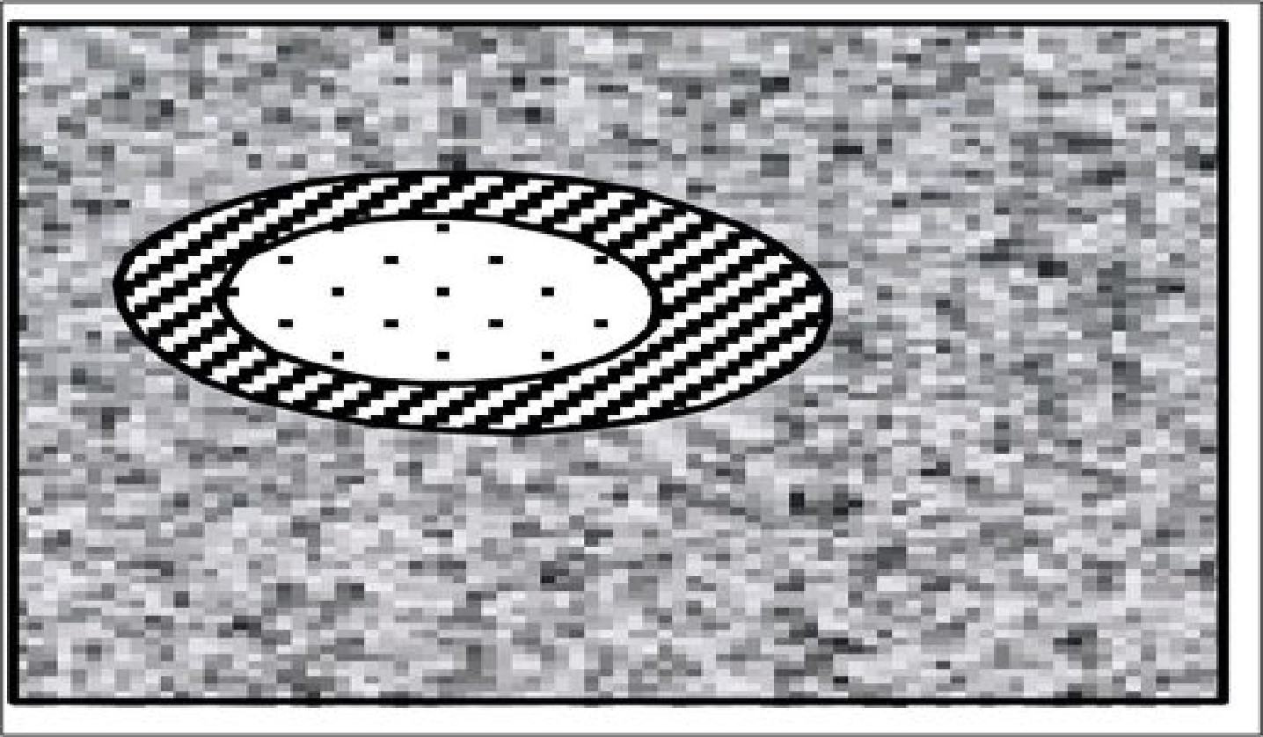
Product Line Scope
Some products are in scope (white)
Some products are out of scope (speckled)
Some products need to be decided on a case by case basis (lined)

Slide 67
Scope is a Critical Decision
Too broad a scope and the systems become difficult to design and construct.
Too narrow a scope and there are too few systems to justify the additional expense and complexity.
Scoping decisions made by
- finding commonality and variation points among potential products
- interactions between marketing and the architect to define as broad a scope as technically feasible without introducing excessive cost when building products.

Slide 68
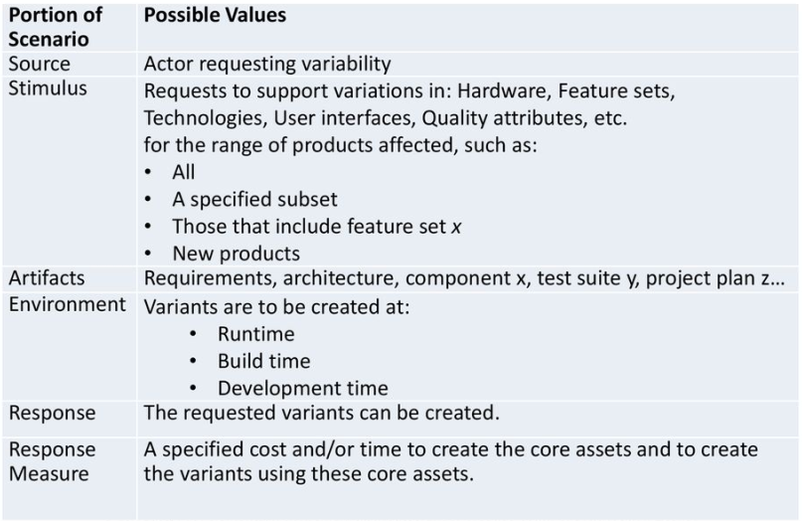
Variability General Scenario

Slide 69
Architectural Mechanisms for Variability
Inclusion or omission of elements:
- Through build procedures for different products, you can include a different number of replicated elements
- For instance, high capacity variants might be produced by adding more servers.
- The actual number should be unspecified, as a point of variation. This may be chosen dynamically

Slide 70
Other Variability Mechanisms
Extension points. These are identified places in the architecture where additional behavior or functionality can be safely added.
Reflection. This is the ability of a program to manipulate data on itself or its execution environment or state. Reflective programs can adjust their behavior based on their context.
Overloading. This is a means of reusing a named functionality to operate on different types. Overloading promotes code reuse, but at the cost of understandability and code complexity.

Slide 71
Other Variability Mechanisms
Inheritance; specializing or generalizing a particular class
Component substitution
Add-ons, plug-ins
Templates
Parameters (including text preprocessors)
Generator
Aspects
Runtime conditionals
Configurator

Slide 72
Each Mechanism had a Cost
Costs include
- The skill set required to implement mechanism
- One time cost for establishing mechanism
- Recurring cost for each instance
- Impact on qualities such as
- Performance
- Modifiability

Slide 73
Evaluating a Product Line Architecture
- Largely the same as a normal evaluation.
- Special attention should be paid to variation points.
- Can be applied to
- core assets, to assess suitability for product line
- instance architecture, to assess suitability for a particular desired product.

Slide 74
Summary
A product line is strategic, planned reuse.
The product line approach to developing software can pay huge dividends.
Requires an understanding of:
- Architecture
- Organizational Architecture
- Process issues

